Slide 1

Part 4.0
Standardised Interpretation of Paediatric Cervical Spine Radiographs
Done in collaboration with:
The Northern School of Radiology, UK
County Durham and Darlington NHS Foundation Trust
Authors:
Dr. Nadia Mcallister MD
Dr. Alasdair Mackie MD
Dr. Abdelrahman Omer MD
Dr. Ramdas Senasi MD
Dr. Sarath Bethapudi MD

Slide 2
Aim
Demonstrate a systematic approach in the interpretation of paediatric C-spine x rays using ABCDEF approach.

Slide 3
Systematic approach
Technique
A – alignment
B – bones
C – cartilage
D – disc (and other) spaces
E – effusion (soft tissues)
F – foreign body

Slide 4
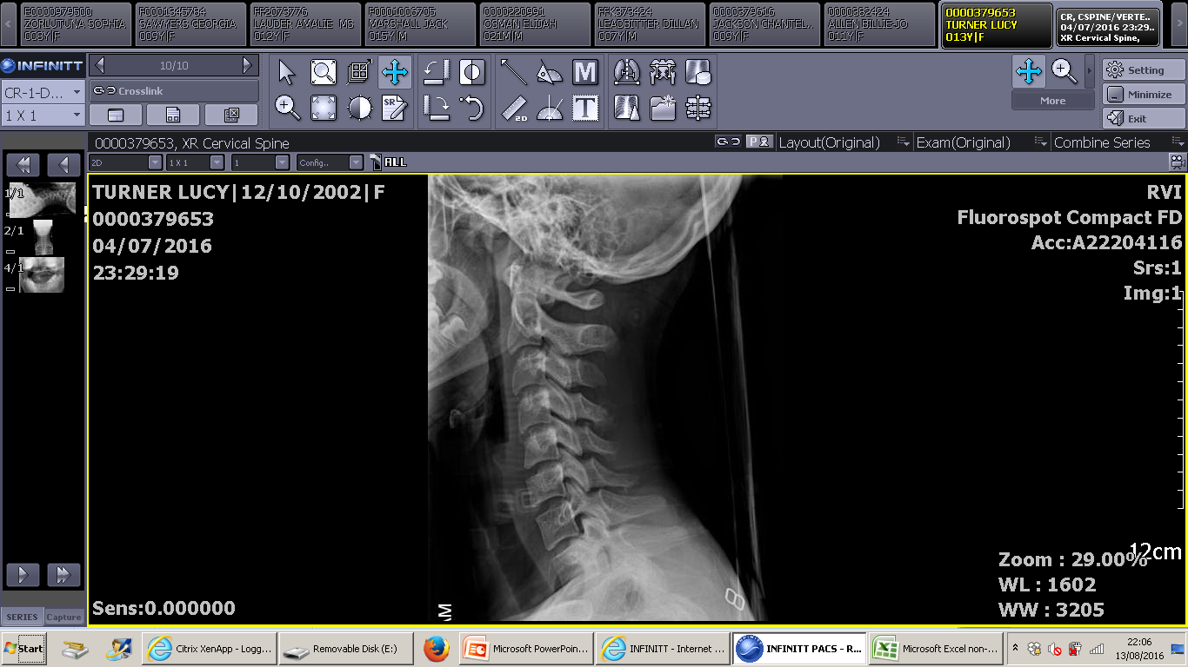
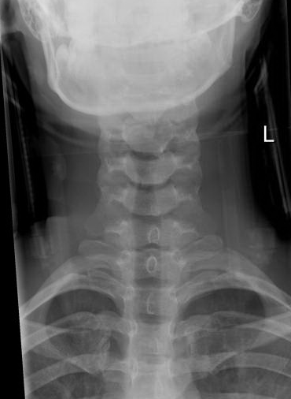
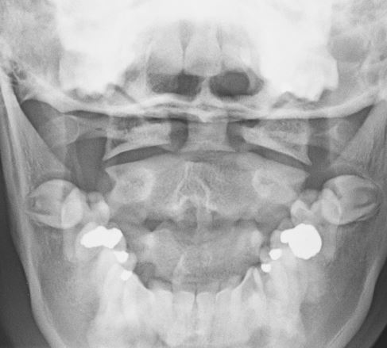
Technique: 3 views
Lateral view:
MUST include
C1 to C7 vertebrae
C7/T1 junction
C1/ occipital junction
Antero-posterior (AP) view
Open-mouth odontoid view

Slide 5
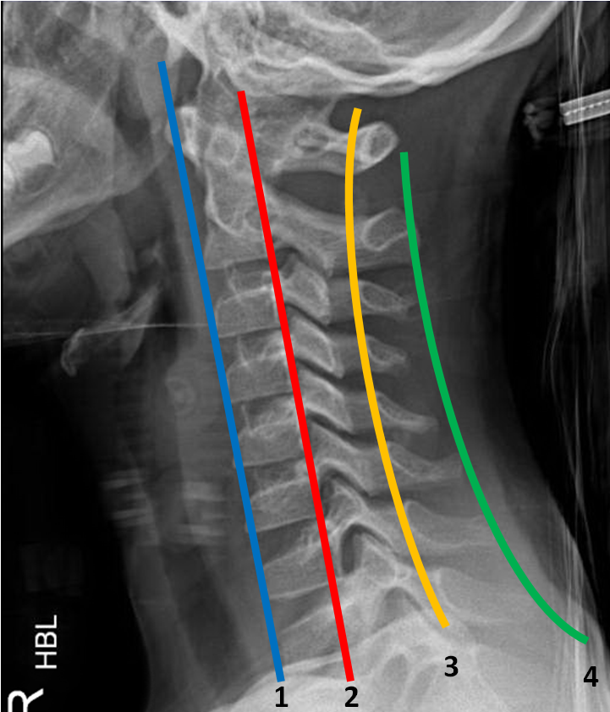
A – assess alignment
Assess 4 parallel lines for smoothness, no steps and no angulation:
1. Anterior vertebral line: anterior margin of vertebral bodies
2. Posterior vertebral line: posterior margin of vertebral bodies and anterior wall of the spinal canal
3. Spino-laminar line: posterior wall of the spinal canal
4. Posterior spinous line: tips of the spinous processes

Slide 6
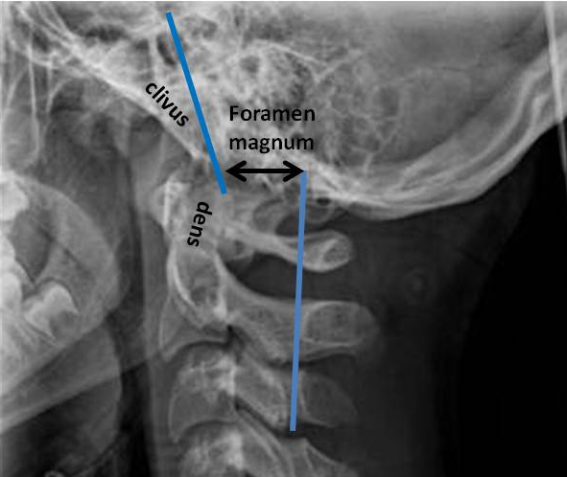
A – assess atlanto-occipital alignment
The anterior margin of the foramen magnum should line up with the dens. Confirm that clivus points at the dens.
The posterior margin of the foramen magnum should line up with the C1 spino-laminar line.

Slide 7
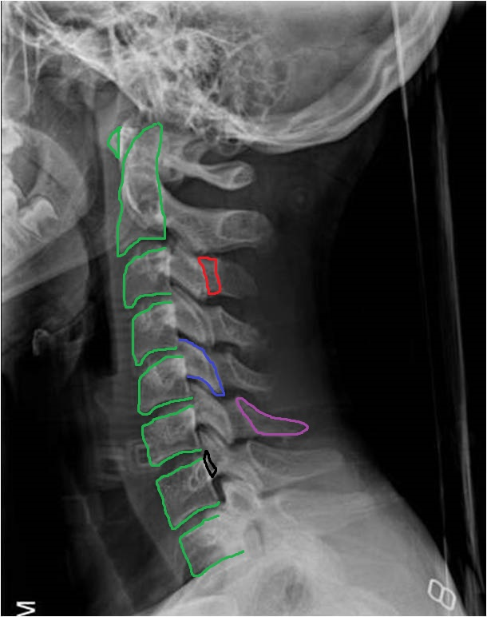
B – assess bones for fractures
Trace the outline of each vertebral body. Below C2 they should be approximately the same height and shape (rectangular in shape).
Trace the outline of each pedicle, lateral mass, lamina and spinous process.
  Note. The pedicles connect the lateral masses to the vertebral bodies; the lamina connect the lateral masses to the spinous processes.

Slide 8
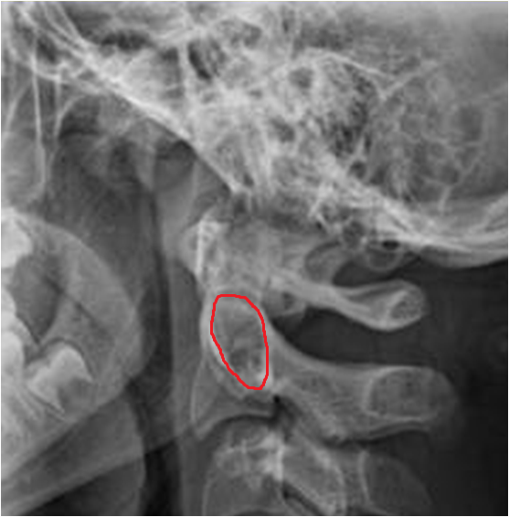
B - assess bony Harris’ ring
Ring of Harris is a ring-like structure resulting from projection of the lateral masses of C2 on its body.
Assess bony outlines for continuity. A fracture can be seen as a step in the ring outline.

Slide 9
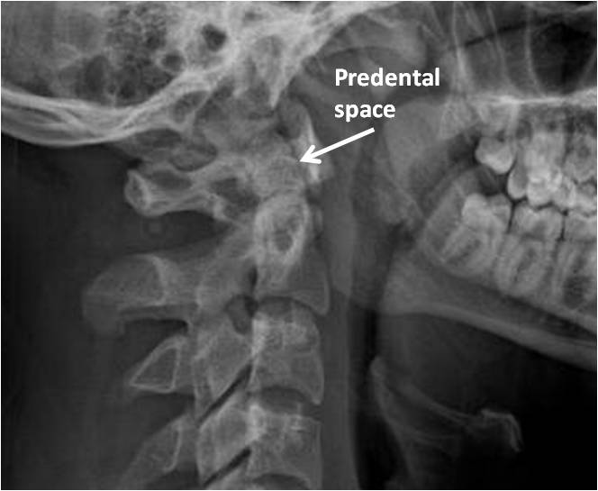
C – assess cartilaginous space
Predental space = space between the odontoid peg and the anterior arch of C1.
<5 mm in ≤8 years old and <3mm in >8 years old
Increased distance implies disruption of the transverse ligament +/- fractures of C1.

Slide 10
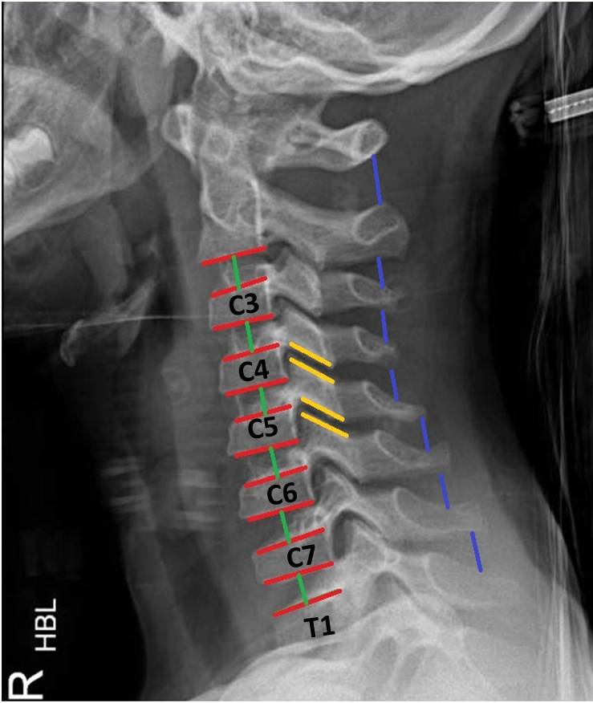
D – assess disc (and other) spaces
Assess intervertebral disc spaces
  Equal in height at all levels
  Symmetric and parallel
Assess facet joint spaces
  Equal distance at all levels
Assess spaces between spinous processes
  C1 – C2 space is large
  C3 – C7 spaces are similar in size

Slide 11
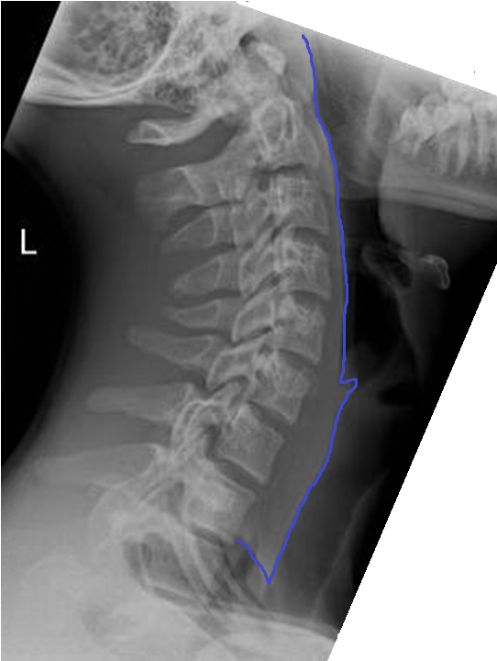
E – assess for effusion (soft tissues)
Assess soft tissues for effusion, which could be due to:
  Prevertebral haematoma from a fracture
  Soft tissue oedema from infection/ abscess
C2-C4 prevertebral soft tissue is in close proximity to the vertebral bodies.
Less than 7mm at C2 level.
Less than 14 mm at C5-C7 level.

Slide 12
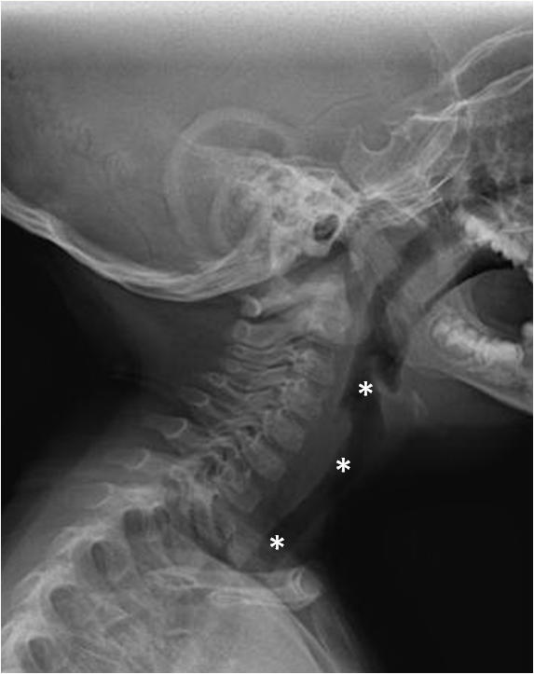
F – assess for foreign bodies
Assess airway for foreign bodies and obstruction (*).

Slide 13
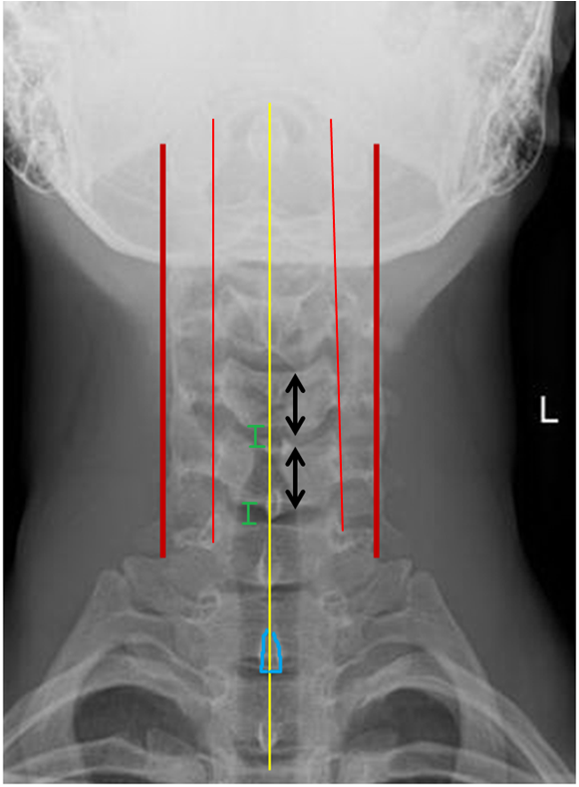
AP view: systematic approach
Alignment:
  assess 4 parallel lines for smoothness using the edges of the vertebral bodies and transverse processes
  assess spinous processes for being in the midline and in strict alignment
Bone:
  trace the outline of each vertebral body and assess for equal height
  trace the outline of each transverse process and dens
Disc (and other) spaces:
  assess intervertebral disc spaces: equal in height at all levels
  assess spaces between spinous processes: equal distances

Slide 14
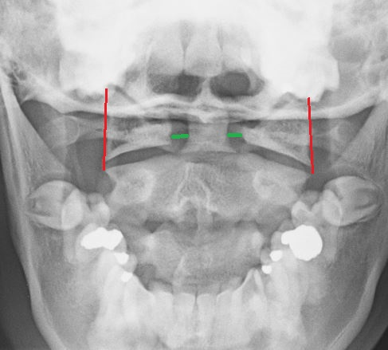
Open mouth odontoid view
Alignment
  Assess distances from the dens to the lateral masses of C1
    Equal bilaterally
  Assess 2 parallel lines joining the tips of the lateral masses of C1 with the tips of the superior articular facets of C2 for alignment
  Any asymmetry raises suspicion of a fracture
Bones
  Trace the outline of C1 and C2

Slide 15
Summary of normal measurements of upper cervical spine on x-ray
Measurement | Value, mm
Basion dens interval | <12
Basion axial interval | 12 anterior to 4 posterior
Powers ratio (calculated by dividing the distance between the basion and posterior arch of C1 by the distance between the opisthion and anterior arch of C1) | <1
C1-C2 intraspinous distance | <12
Predental space | <5 in ≤8 years old and <3 in >8 years old

Slide 16
Normal developmental findings that can be misinterpreted as abnormal
Finding | Comment
Anterior wedging of vertebral bodies | Usually present up to age of 8. Adjacent vertebral bodies are similar.
Pseudo-subluxation of C2 on C3 | Common, 40% of children <7 years
Widened predental space | Seen in 20% of children <8 years
Radiolucent synchondrosis between the odontoid and C2 | Seen in all children <4 years and in 50% <10 years
Variable size prevertebral soft tissue | Variable with breathing, crying, swallowing, flexion of the neck and large adenoids.

Slide 17
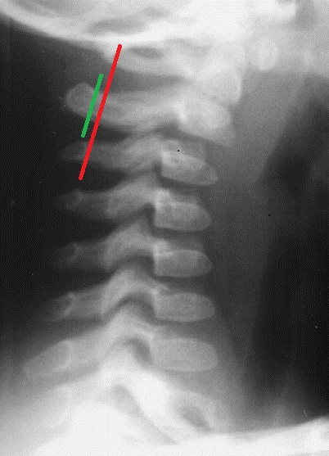
C2-C3 pseudosubluxation
Pseudosubluxation = physiologic misalignment that usually occurs at C2-C3 level in 40% of children < 7 years old.
To distinguish pseudosubluxation from a traumatic subluxation:
Draw a posterior cervical line between the spinolaminar lines of C1 and C3.
This line should pass through or be less than 2mm anterior to the C2 spinolaminar line to be considered physiological.
If the distance is >2mm, the subluxation must be considered traumatic.
Pseudosublaxation is exaggerated with the neck flexed. Extension views can help differentiate the causes.
Image taken from: http://www.hawaii.edu/medicine/pediatrics/pemxray/pemxray.html

Slide 18
How will you approach the following radiographs?

Slide 19
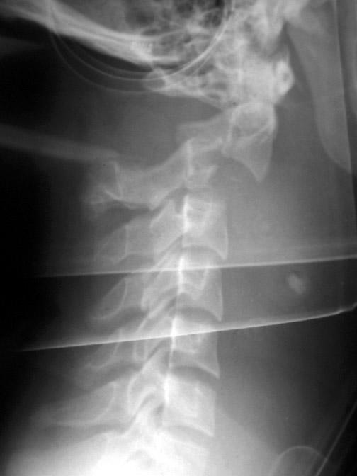
Example 1: what is the abnormality?
Image taken from: www.emedicine.medscape.com

Slide 20
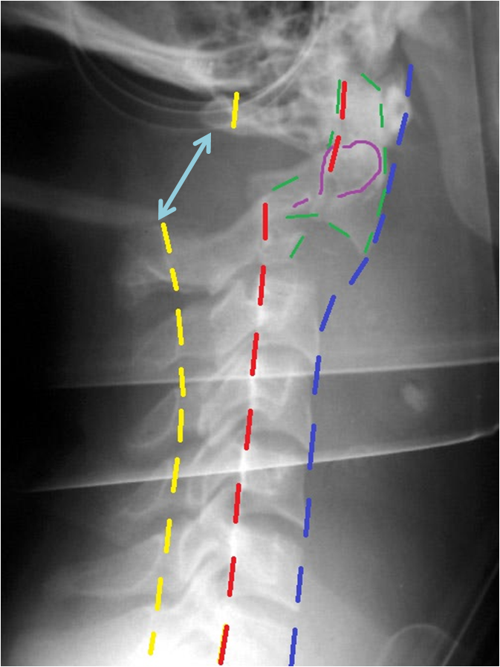
C2 fracture dislocation
A – abnormal anterior, posterior and spino-laminar lines alignment.
B – abnormal bony outline of C2 vertebra. Discontinuity of ring of Harris.
C – normal predental space.
D – enlarged C1-C2 interspinous space (arrow).
E, F – difficult to assess on this X-ray.

Slide 21
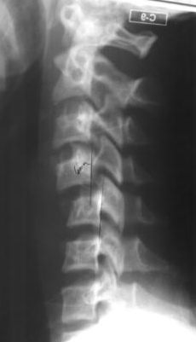
Example 2: what is the abnormality?
Image taken from: http://www.hawaii.edu/medicine/pediatrics/pemxray/pemxray.html

Slide 22
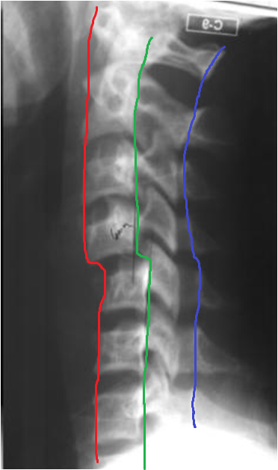
C4-C5 subluxation
A – abnormal anterior, posterior and spino-laminar lines alignment. C4 is displaced anteriorly on C5.
B – bones
C – cartilage
D – disc (and other) spaces
E – effusion (soft tissues)
F – foreign body

Slide 23
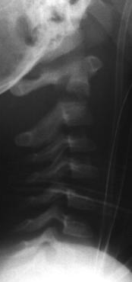
Example 3: what is the abnormality?
Image taken from: http://www.hawaii.edu/medicine/pediatrics/pemxray/pemxray.html

Slide 24
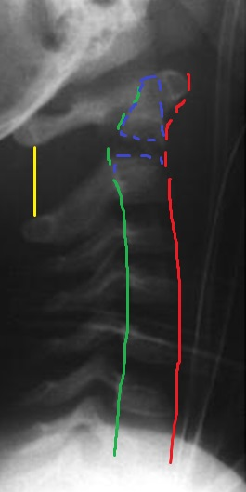
Odontoid fracture
A – abnormal anteriorand posterior lines alignment.
B – abnormal bony outline of C2 vertebra with widened lucency at the base. Anterior tilting of the odontoid. Discontinuity of ring of Harris.
C – cartilage
D – enlarged C1-C2 interspinous space.
E – effusion (soft tissues)
F – foreign body

Slide 25
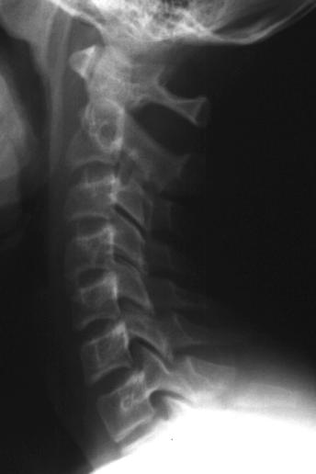
Example 4: what is the abnormality?
Image taken from: http://www.hawaii.edu/medicine/pediatrics/pemxray/pemxray.html

Slide 26
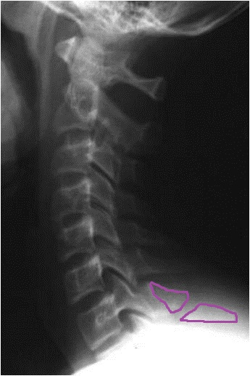
C7 spinous fracture
A – alignment
B – abnormal bony outline of C7 spinous process
C – cartilage
D – disruption of C6-C7 interspinous space
E – effusion (soft tissues)
F – foreign body

Slide 27
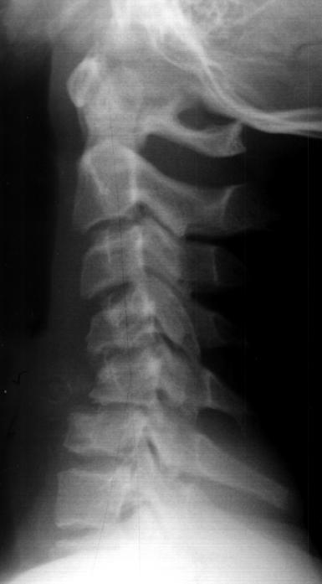
Example 5: what is the abnormality?
Image taken from: http://www.hawaii.edu/medicine/pediatrics/pemxray/pemxray.html

Slide 28
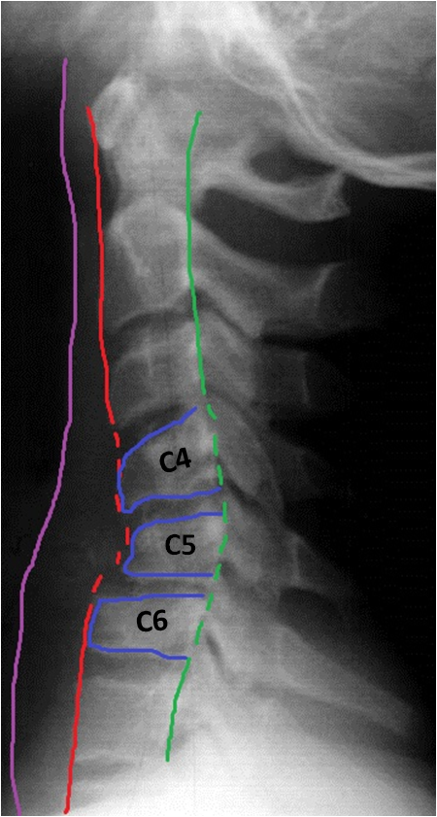
C4-C5 wedge compression fractures
C6 compression fracture
A – abnormal anterior and posterior lines alignment
B – abnormal bony outline of C4, C5 and C6 vertebral bodies (shortened). Posterior subluxation of C5 on C6.
C – cartilage
D – disc (and other) spaces
E – widened prevertebral soft tissue at C4-C6 level.
F – foreign body

Slide 29
Summary
Ensure cervical spine has been adequately imaged.
Adopt a systematic approach.
Knowledge of normal developmental anatomy and normal variants is important.
Imaging findings are to be interpreted in the context of age and mechanism of injury.
Upper cervical spine injuries are more common in paediatric population.
In the context of trauma, consider cross-sectional CT/MR imaging if X-rays are inconclusive and cannot safely exclude underlying cervical spine injury.

Slide 30
References
Booth TN. Cervical spine evaluation in pediatric trauma. AJR:198, May 2012.
The Royal College of Radiologists. Paediatric trauma protocols. London: The Royal College of Radiologists, 2014.
O. Adib, E. NOIZET, D. Loisel et al. Radiographic atlas of pediatric cervical spine in emergency: normal anatomy, variants and pitfalls. European Society of Radiology, ECR Congress 2014.

